Slide 1
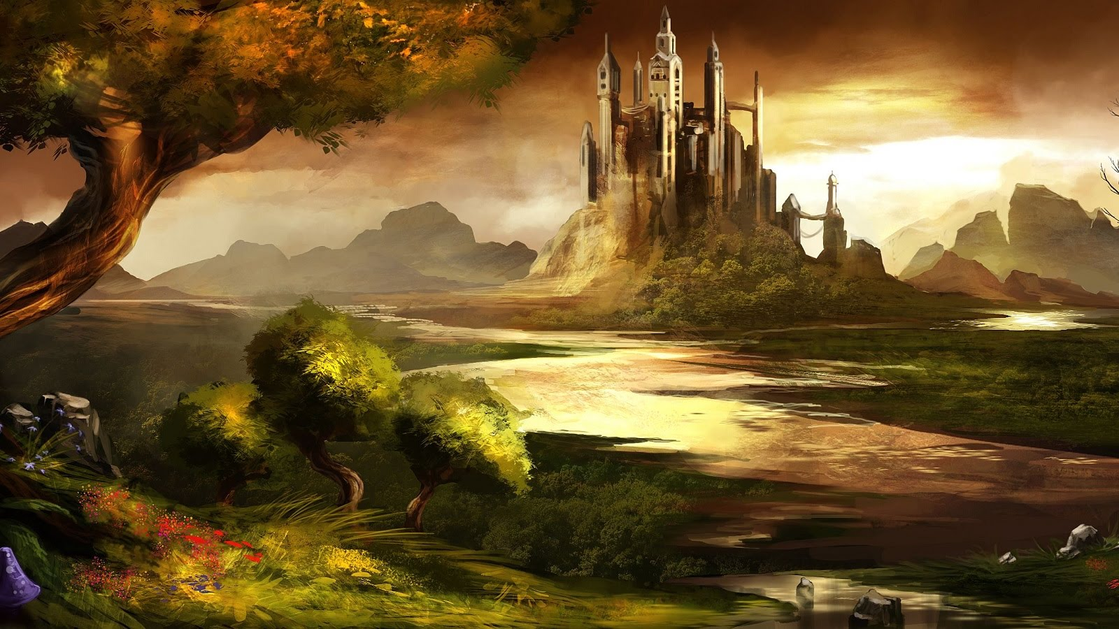
Realms Adventure
Creators: Sergey,Matt,Laver,Vladislav.

Slide 2
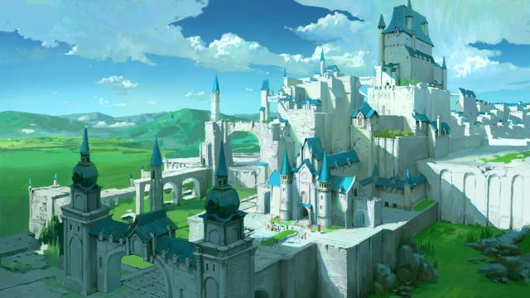
Realms Adventure
Retro Choose Your Own Adventure Dungeon Crawler
Adventure stores are dominated by action.
They involve danger,risk,and excitement
The action is often fast-paced
They are sometimes in exotic or distant places.
The game includes a story that btings you to resulting action

Slide 3
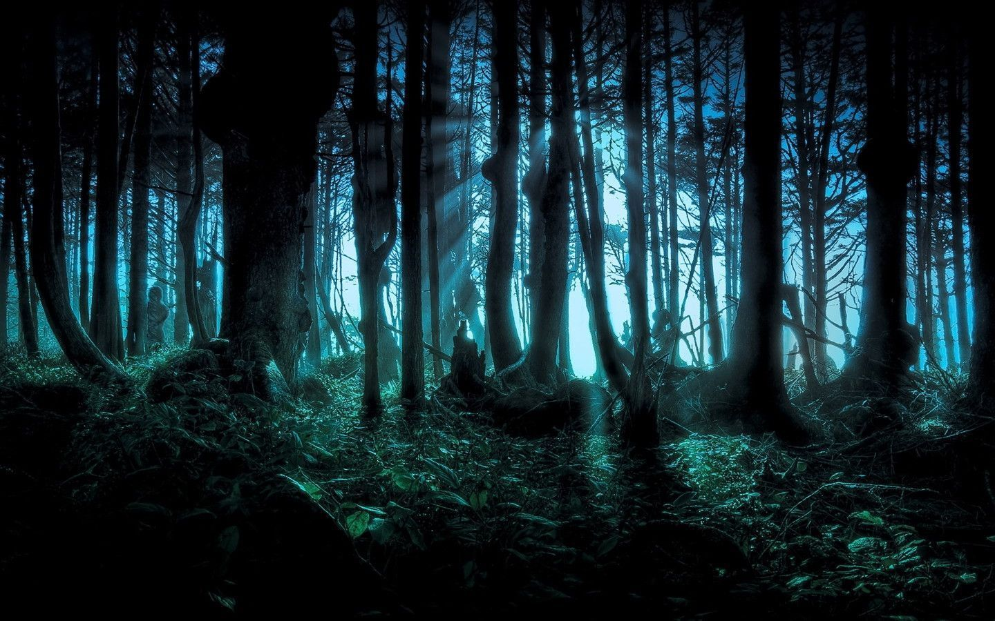
About the game
You find yourself on the shores of Lake Valford. To the west lies the town of Wintercrystal, and to the east Butteroak Forest.
You can decide what place you want to visit, in each town, forest or bar you will meet with people and fight monsters, after each fight that you win you will need to collect coins .

Slide 4
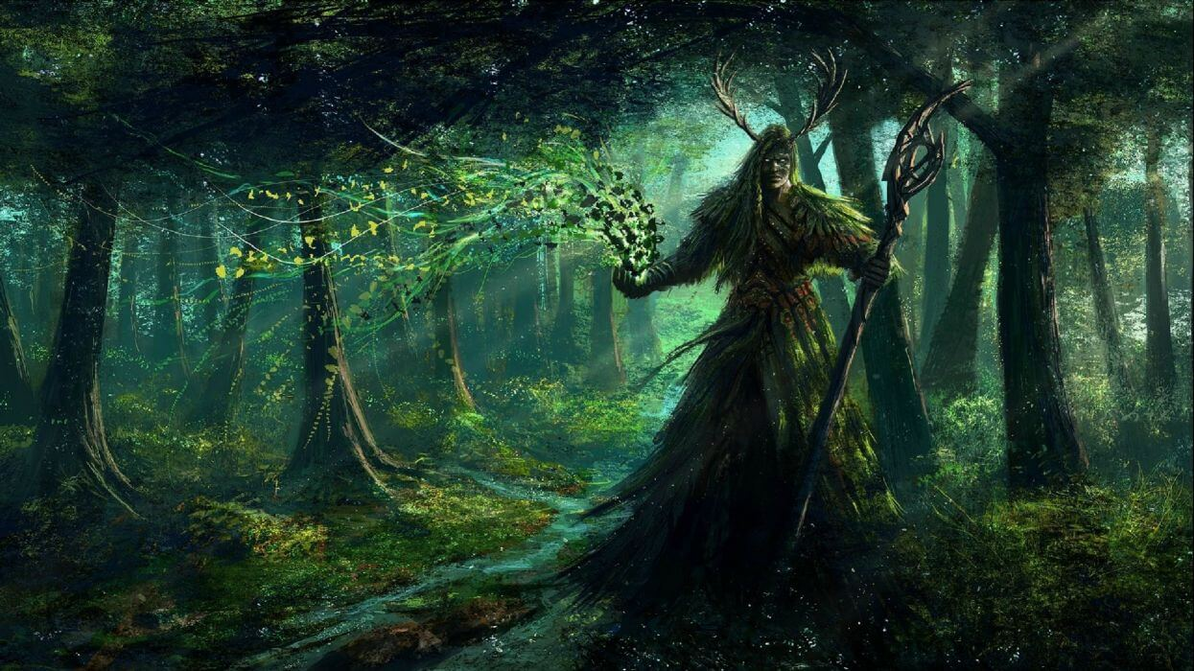
Technologies of the game
For this project we were using html and css3. This is includes 2D transitions, 2D transforms, and animation.

Slide 5
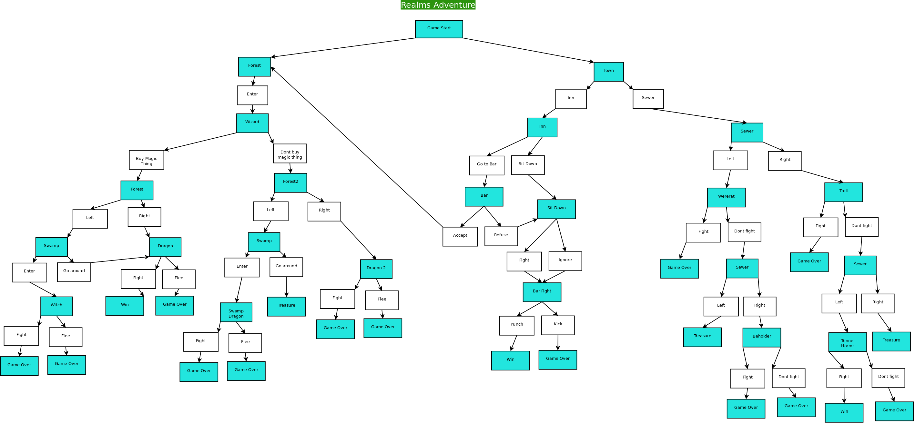

Slide 6
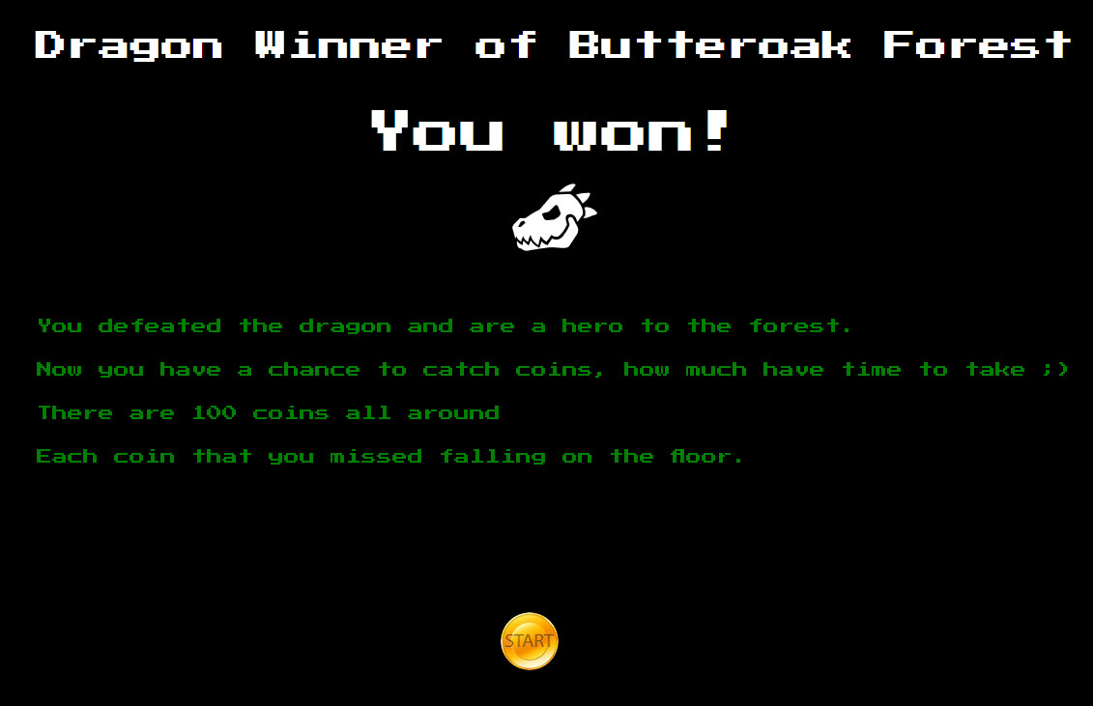
The game ends with several options.
But for each of the options for ending the game there is a surprise.
Surprise is a game in the game.

Slide 7
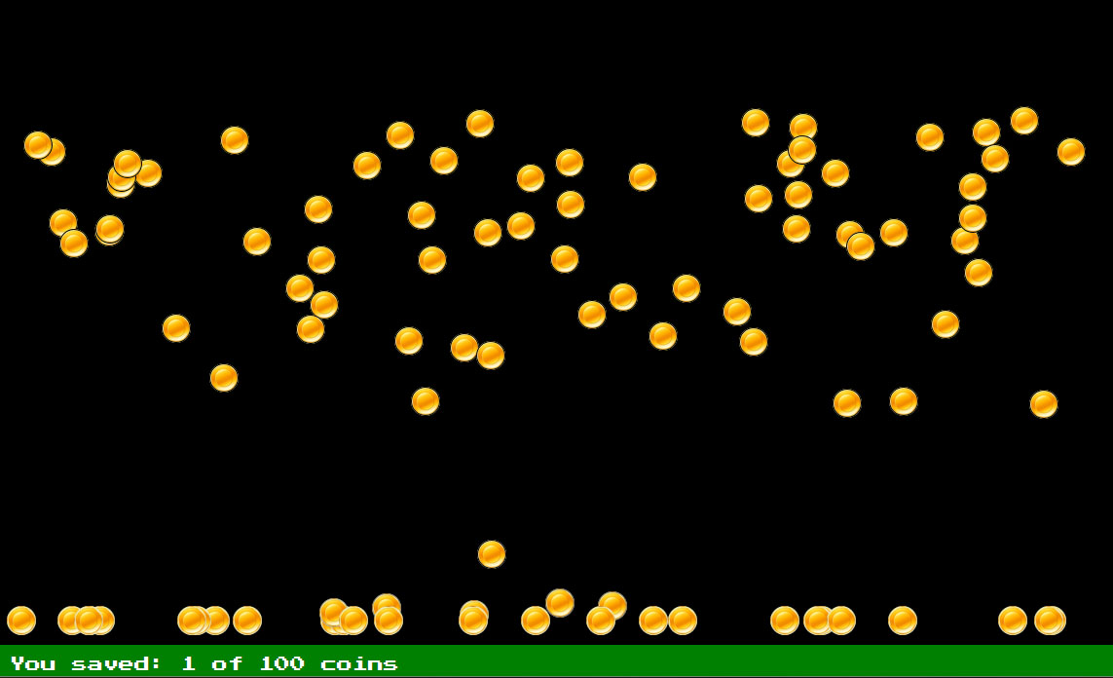
It is 100 input type="radio" stylized coins using CSS

Slide 8
Each coin begins its flight from its point and has its own flight coordinates.
.coin:hover {
cursor: url("../img/manybag.png") 15 25, auto;
}
.coin__1 {
-webkit-animation: coin 30s linear 4.3485653839s forwards;
animation: coin 30s linear 4.3485653839s forwards;
-webkit-animation-play-state: paused;
animation-play-state: paused;
left: 34.0995376082%;
}
.coin_1:checked ~ .coin__1 {
opacity: 0;
-webkit-transform: translate(-50%, -50%) scale(0.01);
transform: translate(-50%, -50%) scale(0.01);
transition: all 0.1s linear;
}

Slide 9
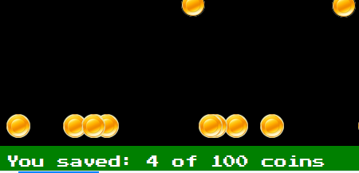
At the bottom of the page there is a counter that records the number of elements clicked.
.game-check:checked {
counter-increment: game;
}
.score span:after {
content: counter(game);
}

Slide 10
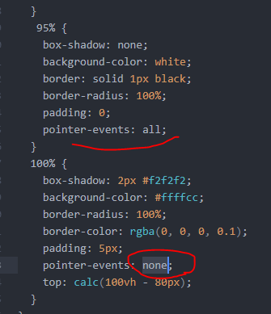
Elements that have performed the animation at 100% become inactive. So that players do not collect money from the floor ))

Slide 11
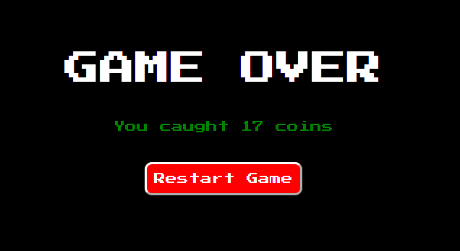
After the time of all the animations has ended, the keyframe works with the output of the result.

